Slide 1
WebGL Introduction
Dr. Lathsamy Chidtavong
Mobile: +8562077712077
Email: l.chidtavong@nuol.edu.la
More Link: https://www.programmersought.com/article/36856616282/
https://sites.google.com/site/webglbook/

Slide 2
Overview of WebGL
WebGL is a technology that enables drawing, displaying, and interacting with sophisticated interactive three-dimensional computer graphics (“3D graphics”) from within web browsers.
Traditionally, 3D graphics has been restricted to high-end computers or dedicated game consoles and has required complex programming.
However, as both personal computers and, more importantly, web browsers, have become more sophisticated, it has become possible to create and display 3D graphics using accessible and well-known web technologies.
WebGL, when combined with HTML5 and JavaScript, makes 3D graphics accessible to web developers and will play an important role in the development of next generation, easy-to-use and intuitive user
Notes:
intuitive user ผู้ใช้ที่ใช้งานง่าย

Slide 3
Overview of WebGL
WebGL, is used to Draw and render complex Three-dimensional Graphics and allow users to Interactive Technology.
In the traditional sense, in order to display three-dimensional graphics, developers need to use C or C++ language, supplemented by a specialized computer graphics library, such as OpenGL to develop an independent application.
Now with WebGL, we only need to add some additional 3D graphics code to the familiar HTML and JS, and then we can display 3D graphics on the web page.
WebGL is embedded in the browser, you can use it directly without installing plug-ins and libraries. Moreover, because it is browser-based, you can run WebGL programs on multiple platforms.

Slide 4
Advantages of WebGL
Over the years, with the development of HTML, web pages have become more and more complex. In the beginning, HTML was only static content. Later, scripting languages ​​such as JS were introduced.
HTML began to provide some dynamic content with a certain degree of interactivity.
Now there is a more powerful HTML5, which can use the canvas tag to draw two-dimensional graphics on the web page to present richer content, such as a dancing cartoon villain, which is updated in real time according to the input Map and so on.

Slide 5
Advantages of WebGL
WebGL allows JS to display and manipulate 3D graphics on web pages. With the help of WebGL, it has become possible to develop 3D customer interfaces, run 3D web games, and visualize massive amounts of data on the Internet.
WebGL is amazingly powerful, its development is extremely simple:
You only need one text editor with one Browser, You can start to write 3D graphics programs.
You can use common Web technology to publish 3D graphics programs and show them to your friends and other developers.
You can take full advantage of the features of the browser.
There are a lot of ready-made materials on the Internet, which can help you learn WebGL, write 3D programs and so on.

Slide 6
The origin of WebGL
The two most widely used 3D graphics rendering techniques on personal computers are Direct3D with OpenGL.
Direct3D is a part of Microsoft's DirectX technology, a set of programming interface API controlled by Microsoft, mainly used in Windows platform.
OpenGL is widely used on multiple platforms due to its development and free features. Windows also provides good support for OpenGL, and developers can also use it instead of Direct3D.

Slide 7
The origin of WebGL
OpenGL Series
The OpenGL graphics system is a software interface to graphics hardware. (“GL” stands for “Graphics Library”.)
It allows you to create interactive programs that produce color images of moving, three-dimensional objects.
With OpenGL, you can control computer-graphics technology to produce realistic pictures, or ones that depart from reality in imaginative ways.

Slide 8
The origin of WebGL
OpenGL was originally developed by SGI (Silicon Graphics International) and released as an open source standard in 1992. Over the years, OpenGL has developed several versions and has had a profound impact on 3D graphics development, software product development, and even movie production.
WebGL is rooted in OpenGL, it is actually a special version from OpenGL OpenGL ES Derived from the latter, the latter is dedicated to embedded computers, smart phones, home game consoles and other devices.
OpenGL ES was first proposed in 2003-2004, and was upgraded twice in 2007 (ES 2.0) and 2012 (ES 3.0). WebGL is based on OpenGL ES 2.0
Link: https://en.wikipedia.org/wiki/OpenGL_ES
Notes:
profound impact ผลกระทบที่ลึกซึ้ง

Slide 9
WebGL program structure
In HTML, dynamic web pages include two languages, HTML and JS. After the introduction of WebGL, the shader language GLSL ES needs to be added.
In other words, the WebGL page contains three languages:
HTML5 (Hypertext Markup Language)
JS
GLSL ES

Slide 10
3D Graphics Basics
What Is 3D?
3D computer graphics are graphics that use a three dimensional representation of geometric data that is stored in the computer for the purposes of performing calculations and rendering 2D images. Such images may be stored for viewing later or displayed in real-time.
Its components:
the data is represented in a 3D coordinate system;
it is ultimately drawn (rendered) as a 2D image (for example, on your computer monitor);
it can be displayed in real time: when the 3D data changes as it is being animated or manipulated by the user, the rendered image is updated without a perceivable delay.

Slide 11
3D Coordinate Systems
If you are familiar with 2D Cartesian coordinate systems such as the window coordinates of an HTML document, you know about x and y values. These 2D coordinates define where <div> tags are located on a page, or where the virtual pen or brush draws in the HTML Canvas element.
Similarly, 3D drawing takes place (not surprisingly) in a 3D coordinate system, where the additional coordinate, z, describes depth (i.e., how far into or out of the screen an object is drawn).
The coordinate systems are depicted in Figure 1-3, with x running horizontally (left to right), y running vertically, and positive z coming out of the screen.

Slide 12
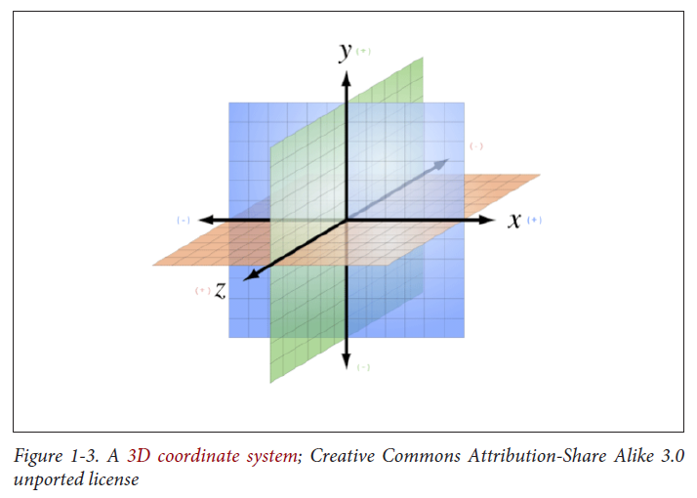
3D Coordinate Systems

Slide 13
3D Coordinate Systems
Note that: WebGL defines positive y as going from the bottom to the top of the window, while the 2D Canvas API and CSS transforms define positive y as going down.
WebGL is based on long lived graphics standards that use the y-up convention, while Canvas and CSS are based on the HTML coordinate y-down convention itself a descendant of time-worn, window-system coordinate schemes.

Slide 14
Meshes, Polygons, and Vertices
A mesh is an object composed of one or more polygonal shapes, constructed out of vertices (x, y, z triples) defining coordinate positions in 3D space.
The polygons most typically used in meshes are triangles (groups of three vertices) and quads (groups of four vertices).
3D meshes are often referred to as models.

Slide 15
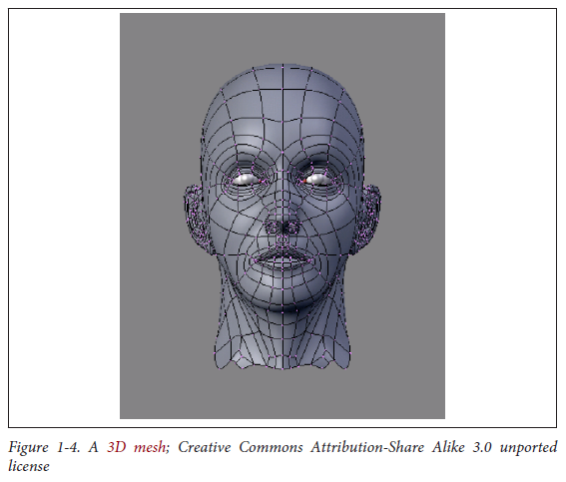
Meshes, Polygons, and Vertices

Slide 16
Materials, Textures, and Lights
You define the surface of a mesh using additional attributes beyond the x, y, and z vertex positions. Surface attributes can be as simple as a single solid color, or they can be complex, comprising several pieces of information that define, for example, how light reflects off the object or how shiny the object looks.
You can also represent surface information using one or more bitmaps, known as texture maps (or simply textures). Textures can define the literal surface look (such as an image printed on a T-shirt), or they can be combined with other textures to achieve sophisticated effects such as bumpiness or iridescence.
In most graphics systems, the surface properties of a mesh are referred to collectively as materials. Materials typically rely on the presence of one or more lights, which (as you may have guessed) define how a scene is illuminated.

Slide 17
Meshes, Polygons, and Vertices
The head in Figure 1-4 has a material with a purple color and shading defined by a light source emanating from the left of the model.
The shadows on the right side of the face.

Slide 18
Transforms and Matrices
3D meshes are defined by the positions of their vertices. It would get really tedious to change a mesh’s vertex positions every time you want to move it to a different part of the view, especially if the mesh were continually animating.
For this reason, most 3D systems support transforms, operations that allow you to move the mesh by a relative amount without having to loop through every vertex, explicitly changing its position.
Transforms allow you to scale, rotate, and translate (move) a rendered mesh without actually changing any values in its vertices.

Slide 19
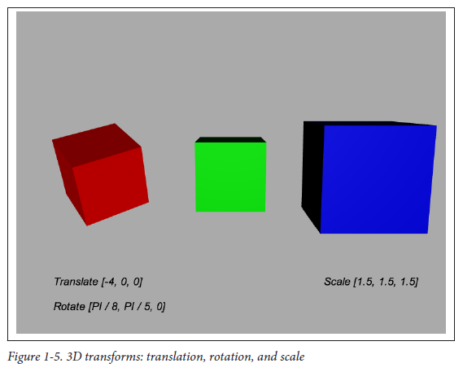
Transforms and Matrices

Slide 20
Transforms and Matrices
Figure 1-5 depicts 3D transforms in action. In this scene we see three cubes. Each of these objects is a cube mesh that contains the same values for its vertices.
To move, rotate, or scale the mesh, we do not modify the vertices; rather, we apply transforms.
The red cube on the left has been translated 4 units to the left (−4 on the x-axis), and rotated about its x- and y-axes.
The blue cube on the right has been translated 4 units to the right, and scaled to be 1.5 times larger in all three dimensions.
The green cube in the center has not been transformed.

Slide 21
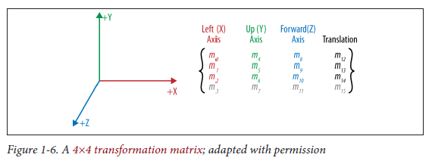
Transforms and Matrices
A 3D transform is typically represented by a transformation matrix, a mathematical entity containing an array of values used to compute the transformed positions of vertices.
WebGL transforms use a 4×4 matrix—that is, an array of 16 numbers organized into 4 rows and 4 columns.

Slide 22
Transforms and Matrices
Figure 1-6 shows the layout of a 4×4 matrix.
The translation is stored in elements m12, m13, and m14, corresponding to the x, y, and z translation values.
x, y, and z scale values are stored in elements m0, m5, and m10 (the diagonal of the matrix).
Rotation values are stored in the elements m1 and m2 (x-axis), m4 and m6 (y-axis), and m8 and m9 (z-axis).
Multiplying a 3D vector by this matrix results in the transformed value.

Slide 23
Cameras, Perspective, Viewports, and Projections
Every rendered scene requires a point of view from which the user will be viewing it.
3D systems typically use a camera, an object that defines where (relative to the scene) the user is positioned and oriented, as well as other real-world camera properties such as the size of the field of view, which defines perspective (i.e., objects farther away appearing smaller).
The camera’s properties combine to deliver the final rendered image of a 3D scene into a 2D viewport defined by the window or canvas.

Slide 24
Cameras, Perspective, Viewports, and Projections
Cameras are almost always represented via a couple of matrices.
The first matrix defines the position and orientation of the camera, much like the matrix used for transforms (as just discussed). It is called the modelview matrix.
The second matrix is a specialized one that represents the translation from the 3D coordinates of the camera into the 2D drawing space of the viewport. It is called the projection matrix.

Slide 25
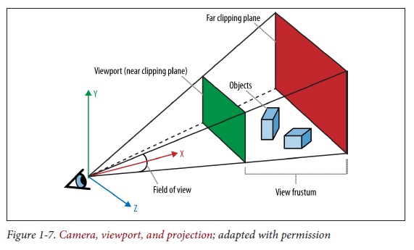
Cameras, Perspective, Viewports, and Projections

Slide 26
Cameras, Perspective, Viewports, and Projections
Figure 1-7 depicts the core concepts of the camera, viewport, and projection. At the lower left we see an icon of an eye; this represents the location of the camera. The red vector pointing to the right (in this diagram, labeled as the x-axis) represents the direction in which the camera is pointing. The blue cubes are the objects in the 3D scene.
The green and red rectangles are, respectively, the near and far clipping planes. These two planes define the boundaries of a subset of the 3D space, known as the view volume or view frustum. Only objects within the view volume are actually rendered to the screen.
The near clipping plane is equivalent to the viewport, where we will see the final rendered image.

Slide 27
Cameras, Perspective, Viewports, and Projections
Cameras are extremely powerful, as they ultimately define the viewer’s relationship to a 3D scene and provide a sense of realism.
They also provide another weapon in the animator’s arsenal: by dynamically moving around the camera, you can create cinematic effects and control the narrative experience.

Slide 28
Shaders
In order to render the final image for a mesh, a developer must define exactly how vertices, transforms, materials, lights, and the camera interact with one another to create that image. The developer does this using shaders.
A shader (also known as a programmable shader) is a chunk of program code that implements algorithms to get the pixels for a mesh onto the screen.
The graphics hardware understands vertices, textures, and little else; it has no concept of material, light, transform, or camera. Those high-level structures are interpreted by the shader program. Shaders are typically defined in a high-level C-like language and compiled into code that can be used by the graphics processing unit (GPU)

Slide 29
Shaders
With shader support now in web browsers, we can get the same production value as a top video game in our WebGL applications, as well as fine control over how CSS elements are presented and animated on a page.
Figure 1-8 shows a WebGL water simulation rendered by a programmable shader. The rippling water and dancing lights are incredibly realistic, and you can interact with the scene while it is simulating, all in real time.
Reminder: this is running in a web browser!

Slide 30
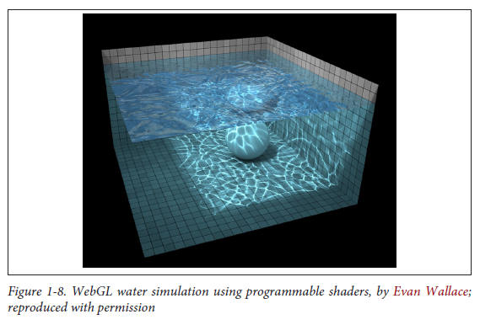
Shaders

Slide 31
ວຽກບ້ານ
ໃຫ້ນັກສຶກສາສັງລວມຄືນກ່ຽວກັບ OpenGL ES
OpenGL ES ແມ່ນຫຍັງ
ພັດທະນາຂຶ້ນມາເພື່ອຫຍັງ, ມີຄຸນສົມບັດຫຍັງ
ວິວັດທະນາການຂອງ OpenGL ES
Link: https://en.wikipedia.org/wiki/OpenGL_ES

